Slide 1
Bilingual Movie sentiment analysis
By Seif El-Berkawy & Rafik Yasser

Slide 2
Outline
Motivation
Challenges
DataSet
Methodology
Results

Slide 3
Motivation
Importance for sentimental analysis
Audience feedback
Market research
Content recommendation
Content creation
Fill the market gap in the Arab world
Useful for bilingual movie viewers

Slide 4
Challenges
Scarcity of reliable arabic datasets
preprocessing the Data
Choosing a suitable training model

Slide 5
DataSet
IMDb has the most movie reviews
Datasets were obtained from IMDb
Both Arabic and English data sets were unbiased
A total of 100K entries

Slide 6
DataSet
Both datasets were preprocessed to remove stop words, punctuation, and other unnecessary character
English dataset was converted to lower case, punctuation and stop words were removed
then tokenized and lemmatized using the NLTK Library
Arabic dataset was preprocessed by removing diacritics, stop words, punctuation and English characters
tokenization and stemming, using ISRI Stemmer

Slide 7
Methodology
Data was preprocessed as mentioned to be used in different approaches
First approach was based on a statistical model with actual understanding of the language
Second approach was based on translating Arabic into english to have one language in training
Third approach was trained separately on each language embedding

Slide 8
First Approach
Both Arabic & English datasets were concatenated after preprocessing
train, test split using sklearn library 80%, 20%

Slide 9
System Architecture
Firstly, SVM was tried but results were poor hence, LSTM was chosen
Model is sequential having multiple layers:
Embedding
Dual layer LSTM
Dual dense layers
Relu
Sigmoid
Loss function

Slide 10
Second Approach
Arabic data to be translated to English
python ‘s Transformers library was used
Translation could be inaccurate
It takes a long time to translate 50K data entries

Slide 11
Third Approach
The model had two different layers, one for each language
FastText embedding was used for both languages
FastText is particularly useful for text classification tasks as it captures not only word-level information but also subword-level information

Slide 12
System Architecture
Model is sequential having multiple layers:
Dual embedding layers
Embedding layer for english text
Embedding layer for arabic text
Dual layer LSTM
LSTM layer for english text
LSTM layer for arabic text
Dual dense layers
Relu
Sigmoid
Loss function

Slide 13
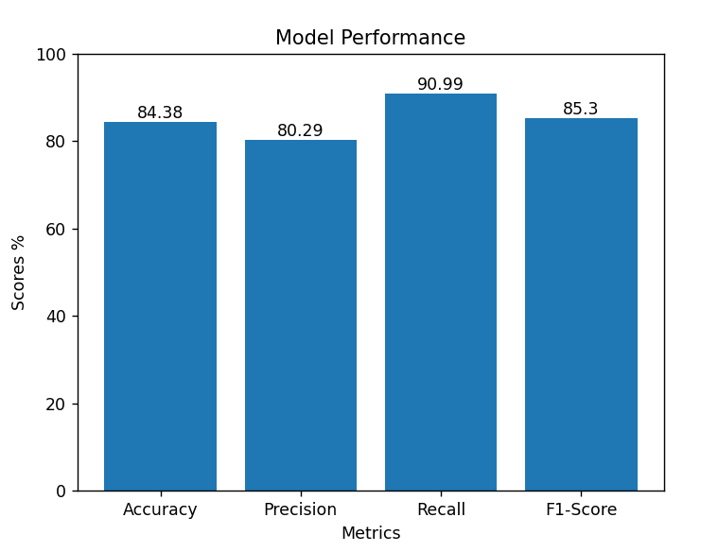
Results first Approach

Slide 14
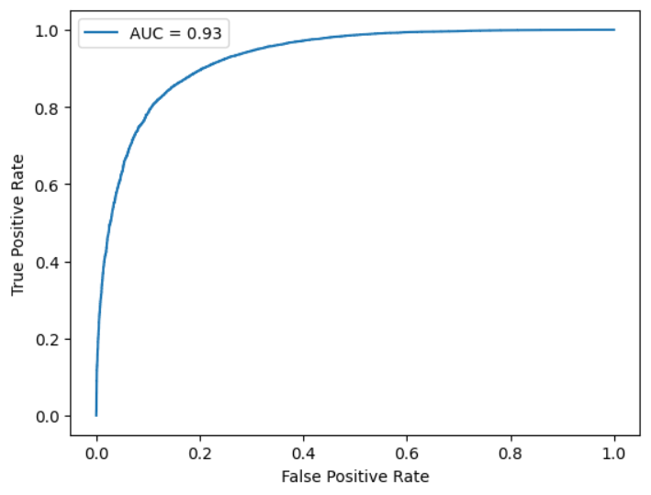

Slide 15
Results First Approach
Two use cases were used
I really enjoyed the Marvel works I am sad that I have not watched the other movies
The movie was terribly amazing
Arabic
لقد استمتعت حقًا بأعمال مارفا، وأنا حزين لأنني لم أشاهد الأفلام الأخرى
كان الفيلم مذهلاً بشكل رهيب
All cases were correctly classified

Slide 16
Results First Approach
To test a negative sentiment we had a third use case
The movie had some good scenes, however in overall I did not like it
كان للفيلم بعض المشاهد الجيدة ، ولكن بشكل عام لم يعجبني

Slide 17
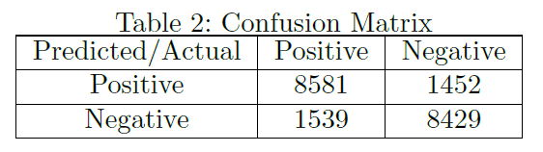
Results First Approach

Slide 18
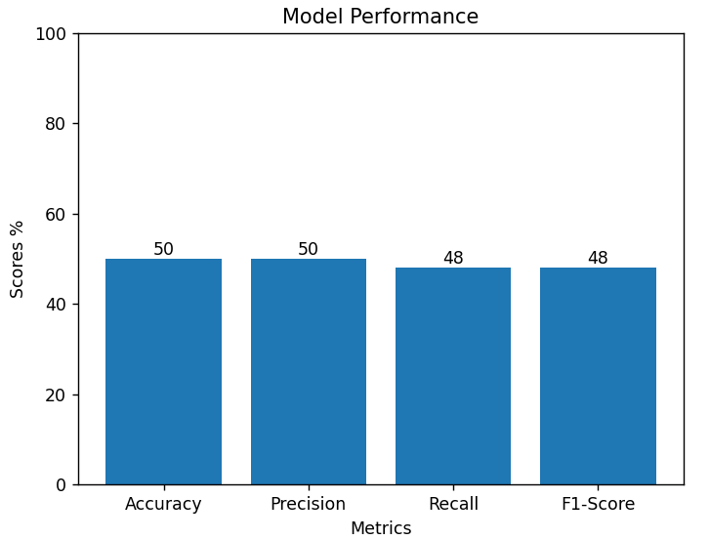
Results Third Approach

Slide 19
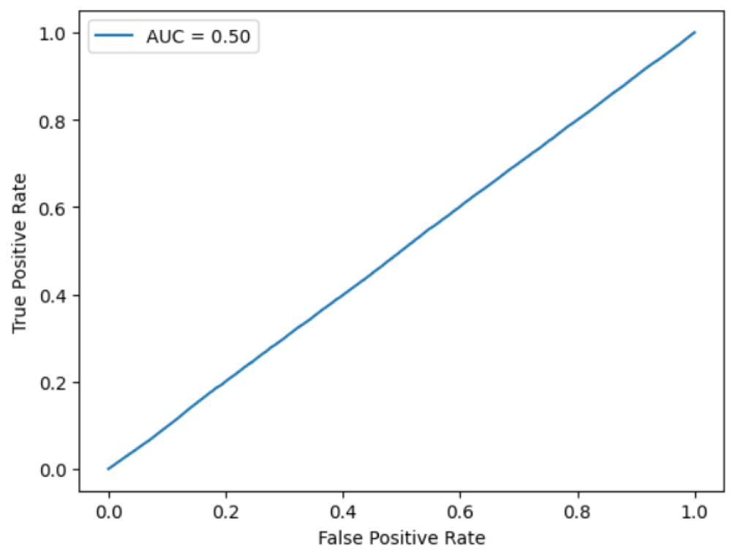

Slide 20
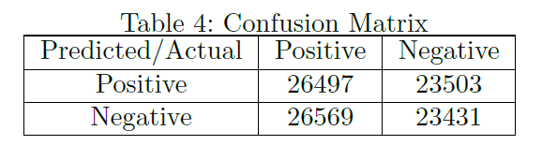
Results Third Approach

Slide 21
Results Third Approach
The first use case and its arabic equivalent were classified correctly
The Other uses cases were all incorrectly identified
Based on the scores and results we can see the model clearly over fits

Slide 22
ANY QUESTIONS
?

Slide 23
Thank You

